Slide 1
Lecture No. 30 Metallurgy
At the end of this lecture, students will be able to:
Explain concentration of aluminum and copper
Discuss the extraction and refining of aluminum and copper
Describe the uses and properties of aluminum and copper

Slide 2
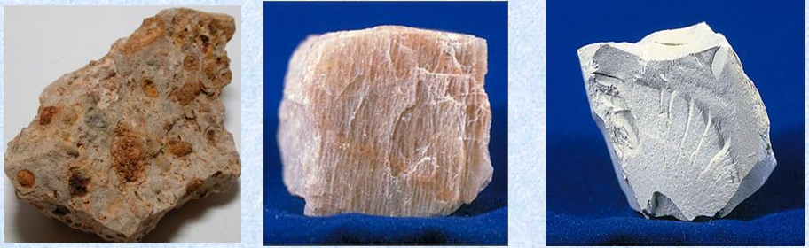
Metallurgy of Aluminum
Occurrence of aluminum:
Aluminum is the third most abundant element in the earth crust
Next to oxygen and Silicon aluminum is more available (8.13 %)
Al has strong affinity towards oxygen so it is available in combined form than native form Al₂O₃.2H₂O
Important aluminum ores:
Bauxite, Al₂O₃.2H₂0
(ii) cryolite, Na₃AlF₆
(iii) Feldspar, KAlSiO₃O₈
(iv) Mica, KAlSiO₁₀ (OH)₂
(v) Kaolinite, Al₂Si₂O₇.2H₂O

Slide 3
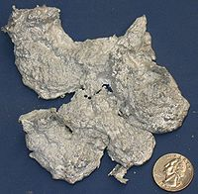
Aluminum extraction from Bauxite
Bauxite, Al₂O₃.2H₂0 occurs as an impure form of aluminum oxide with TiO₂, SiO₂ and Fe₂O₃
Impurities like Fe & Si make aluminum brittle and prone to corrosion
First, the impurities from bauxite are eliminated using different methods such as Baeyer’s process, Hall’s process & Serpek’s process
Aluminum oxide can further be reduced to free aluminum at very high temperatures. But this method is not economical due to high affinity of aluminum for oxygen
Electrolysis is used to get pure aluminum from bauxite

Slide 4
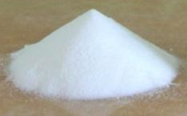
Purification-Baeyer’s Process
If ore contains appreciable amount of Fe₂O₃ this method is preferred to eliminate the impurities like Fe₂O₃ and SiO₂ etc.
Pulverized and calcined ore is treated with hot and strong NaOH under pressure to form sodium meta aluminate
$$Al_{2}O_{3}+2NaOH →2NaAlO_{2 }+ H_{2}O$$
$NaAlO_{2 }$is in the solution and the impurities are undissolved, so filtration helps to separate impurities
This $NaAlO_{2 }$ solution is cooled with excess water,
$$NaAlO_{2 }+ {2H}_{2}O →Al(OH)_{3}↓+NaOH$$
Aluminum hydroxide is further washed and heated to give pure alumina
$2Al(OH)_{3 }→Al_{2}O_{3}\left(pure\right)+3H_{2}O$

Slide 5
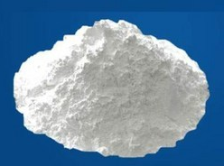
Purification-Hall’s Process
Low grade calcined bauxite is treated with Na₂CO₃ to produce sodium meta aluminate
Al₂O₃ + Na₂CO₃ → 2 NaAlO₂ + CO₂ ↑
$NaAlO_{2 }$is in the solution and the impurities are undissolved, so filtration helps to separate impurities
$NaAlO_{2 }$ solution is heated with CO₂ and excess water,
2 NaAlO₂ + CO₂ + 3H₂O → 2Al(OH)₃ ↓ + Na₂CO₃
Aluminum hydroxide is further washed and heated to give pure alumina
$2Al(OH)_{3 }→Al_{2}O_{3}\left(pure\right)+3H_{2}O$

Slide 6
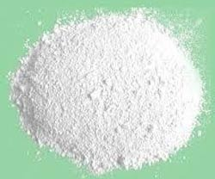
Purification-Serpek’s Process
This method is used when bauxite contains appreciable amounts of silica
bauxite is mixed with carbon and heated up to 1800⁰C in a current of nitrogen
Al₂O₃.nH₂O + 3C + N₂ → 2AlN + 3CO + nH₂O
Aluminium nitride is hydrolyzed with hot water to give aluminum hydeoxide
AlN + 3H₂O → Al(OH)₃ ↓ + NH₃
Aluminum hydroxide is further washed and heated to give pure alumina
$2Al(OH)_{3 }→Al_{2}O_{3}\left(pure\right)+3H_{2}O$

Slide 7
Electro-refining of Aluminum
Electrolysis of alumina yields pure aluminum but to further purify and get 99.99% purity electro-refining is performed
Bottom anode layer consists of impure aluminum
Middle layer consists of cryolite (Na₃AlF₆), alumina and barium fluoride acting as electrolyte
Top cathode layer consists of pure metal. This aluminum layer is connected with graphite electrode
Cell is made of iron box and is lined from inside with carbon

Slide 8
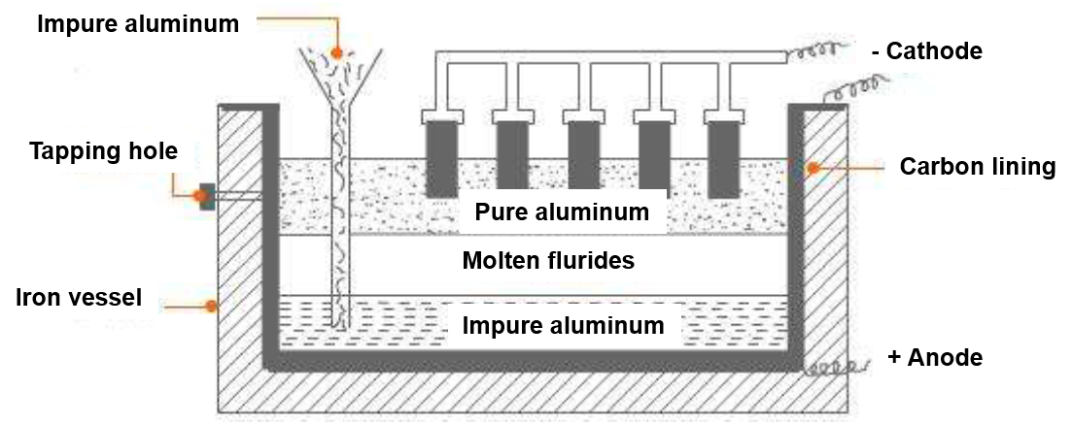
Electro-refining of Aluminum
When electricity is passed aluminum from bottom layer moves to middle and further to top layer
At anode, Al Al³⁺ + 3e⁻
At cathode, Al³⁺ + 3e⁻ Al (pure)
Pure aluminum is removed from the top & impurities are left behind
Pure aluminum is removed from the top and aluminum of lower purity is added to the bottom layer. Thus 99.99% pure aluminum is obtained using electro-refining

Slide 9
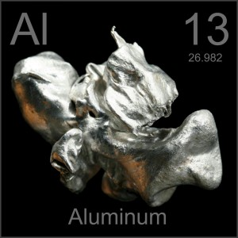
Physical and Chemical properties of Aluminum
Physical properties:
Aluminum is a white metal which forms a protective oxide layer in moist air
It melts at 658⁰C and boils at 1800⁰C
Aluminum is a good conductor of electricity and heat
Chemical properties:
Thin aluminum foil burns readily in air & forms oxide when heated
4 Al + 3O₂ → 2Al₂O₃
Reaction with acids: 2Al + 6HCl → 2AlCl₃ + 3H₂
Reaction with base: Al + 2NaOH + 2H₂O → 2NaAlO₂ + 3H₂

Slide 10
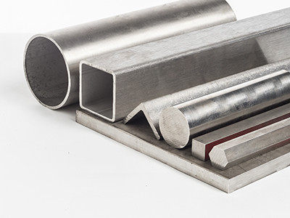
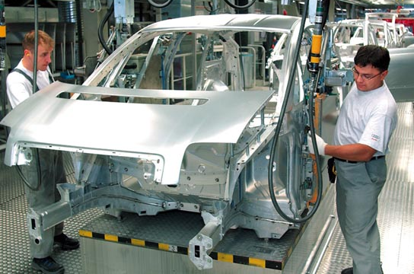
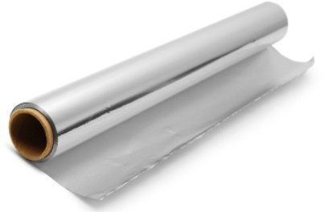
Uses of Aluminum
Because aluminum is light and has high tensile strength, it is used to make automobiles and aircrafts
it is used for making electrical cables due to high electrical conductivity
it is used in making cooking utensils due to high thermal conductivity
used in thermite welding and in the aluminothermic process to reduce metal oxides into free metals
Used in paints, dyes etc.

Slide 11
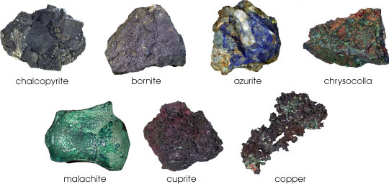
Metallurgy of Copper
Occurrence:
Copper is 25th most abundant element in the earth crust
It is available as a native element and also in combined form
Copper nuggets are largely exhausted
Mostly copper ores have bright colors
Important ores of copper:
Chalcopyrite, CuFeS₂
Chalcocite, Cu₂S
Covellite, CuS
Cuprite, Cu₂O
Malachite, CuCO₃.Cu(OH)₂

Slide 12
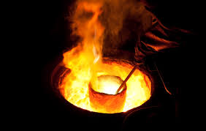
Extraction of Copper
Extraction of Cu from oxide ore:
Oxide ores are directly reduced to metallic copper by the reduction of carbon
$$Cu_{2}O+C →2Cu+CO$$
Extraction of Cu from carbonate ore:
Ore is crushed and concentrated. Later, roasted in the presence of air which yields oxide of the metal
Oxide can be reduced by reduction with carbon
$$CuCO_{3}.Cu(OH)_{2}→2CuO+CO_{2}+ H_{2}O$$
$$Cu_{2}O+C →2Cu+CO$$
Δ
Δ
Δ

Slide 13
Extraction of Copper
Extraction of Cu from sulphide ore:
Cu can be obtained by smelting process
Crushed and concentrated ore is heated in the presence of air
$$2CuFeS_{2}+ O_{2} →Cu_{2}S+FeS+SO_{2}$$
Copper and iron sulphides are further partially oxidized
$$2Cu_{2}S+ O_{2} →2Cu_{2}O+2SO_{2}$$
$$2FeS+ {3O}_{2} →2FeO+2SO_{2}$$
Feo forms slag (FeSiO₃) with silica and can be removed
Cu₂S and Cu₂O are allowed to react which forms metallic copper and SO₂
$$Cu_{2}S+ {2Cu}_{2}O →6Cu+SO_{2}↑$$
When copper is cooled, SO₂ slowly escapes from the surface leaving blisters on the surface of solidified copper which is known as blister copper
Δ

Slide 14
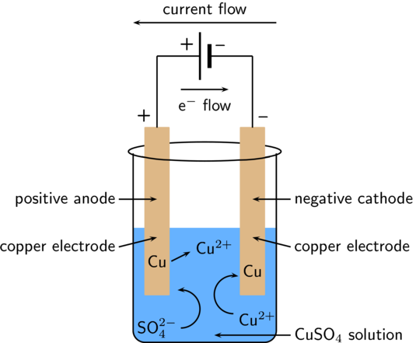
Electro-refining of Copper
Anode is made of Impure copper (blister copper) and cathode is made of pure copper rod or sheet
Acidified CuSO₄ solution is used as the electrolyte
At anode, Cu Cu²⁺ + 2e⁻
At cathode, Cu2⁺ + 2e⁻ Cu (pure)
Many impurities settle down as sludge or mud below the anode (anode mud) & 99.99% pure copper can be prepared
(Pure Cu)

Slide 15

Physical and Chemical properties of Copper
Physical properties of copper:
Copper is reddish brown colored and takes a bright metallic luster
It is malleable, ductile, and a good conductor of electricity and heat
Melting point is 1083°C and boiling point is 2567°C
Chemical properties of copper:
Reacts with oxygen in the atmosphere slowly and
forms a protective layer
Copper structures turn green in color
It tarnishes when exposed to some sulfur compounds

Slide 16
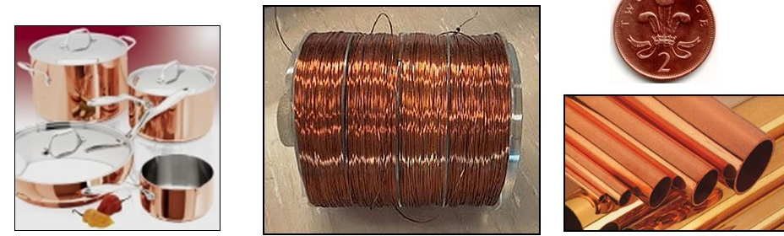
Uses of Copper
Use to make electrical cables and electrical appliance
Used to make water pipes because if its inertness
It forms various alloys which are useful for many industrial processes
Copper compounds are used as insecticides, pesticides, pigments etc.
In many electrochemical processes copper is useful. It can be used as an electrode and used in techniques such as electroplating

Slide 17
Summary
Aluminum is the third most abundant element in the earth crust
Bauxite, feldspar are the important ores of aluminum
Alumina is purified by different processes like Baeyer’s process, Hall’s process & Serpek’s process etc.
Pure alumina is used to produce aluminum metal by electrochemical methods
Aluminum is further purified by electro-refining
Copper is the 25th most available element in the earth crust
Chalcopyrite, Malachite, cuprite etc. ate the important ores of copper
Copper is extracted by pyrometallurgical methods and it is purified by electro-refining

